Slide 1


The magnitude of H&N IMRT dose delivery errors from three possible failure modes: beam quality, symmetry, and MLC position
Jackie Tonigan, M.S.
Advisor: David Followill, Ph.D
University of Texas M. D. Anderson
AAPM Annual Meeting, Charlotte, NC.
August 2, 2012

Slide 2
Motivation
Advanced RT
Increased Complexity and Steps
Need for Increased QM
Notes:
We are in a time of great advancement in radiotherapy. Our ability to treat with more conformal, higher doses is increasing and techniques for accurate target localization are improving. The motivation of this work lies in the fact that with these advances in our treatment techniques comes increased complexity in the treatment process. There are more devices, more inputs, more interfaces, and more complicated procedures. In turn, we have a greater need for comprehensive quality management and with realistic clinical limitations on personnel and time, it is important to have a strong understanding of the entire treatment process and the means by which the process may fail in order to most effectively and efficiently (manage the quality of patient treatments) prioritize quality assurance.

Slide 3
Sensitivity Analysis
Goal: Prioritize QM based on likelihood of error occurrence and severity of clinical impact
Failure Modes and Effects Analysis
  Outline the process
  Identify failure modes and causes
  Determine the risk associated with each FM
    RPN = Risk probability number
      O = Probability of occurrence
      D = Lack of detectability
      S = Severity
  Improve QM
  RPN=O x D x S
Notes:
Sensitivity analysis is an effective way to get a good understanding of the treatment process and the risk associated with failures so that you may prioritize QM, and a number of studies in the radiotherapy community are focusing on Failure modes and effects analysis, or FMEA. An FMEA works first by outlining each step in a process, commonly done in the form of a process tree, then identifying places that errors may occur which would result in a failure of the process, known as a failure mode, and each possible cause of the failure. From there, the risk associated with each failure mode is determined by a score known as the risk probability number, which takes into account the probability of occurrence, the lack of detectability, and the severity. A scale is set and each of these values are determined by a panel of experts based on their opinion of the risk of each component. And the purpose of this work is to reduce the subjectivity of these scores by better understanding the impact of the severity of IMRT failure modes with physical measurement and calculation with the ultimate FMEA goal of identifying the most risky failure modes and using the information to improve quality management.

Slide 4
IMRT Process Tree
MU Linearity
Positioning
CT Lookup Table
Simulation Imaging
Treatment Planning
IMRT QA
Treatment Delivery
Immobilization
Localization
Image Transfer
Measurements
MLC Penumbra Effects
Equipment
Dose Calculation
Interpret Results
MLC Positioning
Beam Quality
Symmetry
Gantry Angle
Treatment
Delivery
Plan Save & Transfer
Collimator Angle
Contouring
Localization
Motion Monitoring
Prescription
Plan Approval
Couch Angle & Displacement
MLC Delivery
Dose Calculation
Mechanical Delivery
Accessories
Notes:
So here is a simplified depiction of the IMRT process, starting off with very basic steps, each of which then have a number of components with a number of possible failure modes and subsequent causes. My project is focusing on what I like to call physical failure modes within the treatment delivery step, and will be measuring the severity of dose delivery errors caused by failures of these listed failure modes. This specific study focuses on these three: MLC positioning, beam quality, and symmetry.

Slide 5
Unique Study Characteristics
Extensive array of measurement capabilities (RPC)
Availability of an accelerator (Clinac 2100CD)
  Just taken out of clinical service
  Modification of operating parameters
Notes:
Within this study are some unique characteristics. First, we had use of the RPC’s extensive measurement capabilities and second, because MDA has been replacing machines, we have access to accelerators being taken out of clinical service that we can, with the assistance of the service engineers, modify their operating parameters

Slide 6
Failure Mode Measurements
MLC position
Beam quality
Symmetry
Standard IMRT plan (1948 MU, 90 seg, 0.482 MCS*)
Complex IMRT plan (3189 MU, 216 seg, 0.171 MCS*)
Output
Beam quality – ratio of depth doses
Profiles (in-plane and cross-plane)
Planar IMRT QA – MatriXX
Phantom IMRT QA – I’mRT Body Phantom
RPC IMRT H&N Phantom (end-to-end test)
*McNiven, et al. Med. Phys. 2010
Notes:
Here is a list of the measurements performed for each of the failure modes. We delivered both a standard H&N IMRT plan, and a more complex plan with higher MU, more segments, and a low modulation complexity score. We controlled for output, measured the beam quality with each adjustment by taking a ratio of depth doses, took profiles, performed planar and 3D phantom IMRT QA and finally delivered the plans to the RPC’s IMRT H&N phantom which as an end-to-end test provides a complete treatment assessment. A baseline was established through measurement of each of these before any alterations were made.

Slide 7
Failure Mode Measurements
MLC Position
  Systematic + 2 mm shift in one bank of leaves
Beam Quality
  DD ratio increased/decreased by ~1%
Symmetry
  Angular Steering: In-plane by ~3.5%, Cross-plane by ~3.5%
  Translational Steering: In-plane by ~3.5%
Notes:
Then each individual failure mode was simulated and the same list of measurements taken. For the MLC positional failure mode, each field was delivered with a systematic 2 mm shift outward in one bank of leaves. For beam quality, the shunt was altered to increased and subsequently decrease the depth dose ratio by 1%. The beam was steered angularly to shift the in-plane and cross-plane symmetry by 3.5% each individually, and finally it was steered translationally to shift the in-plane symmetry by 3.5%. Each of the failure modes was evaluated as an isolated event.

Slide 8
Pilot Study Results
Profiles - MatriXX
No IMRT QA
RPC IMRT H&N Phantom, complex plan:
  Range of 6 PTV TLD dose differences from baseline irradiation
  DTA difference from baseline irradiation (between PTV and OAR)
  7%/4mm gamma index analysis average of axial and sagittal films
 | In-plane | Cross-plane | Beam quality | MLC (all) | MLC (all)
Alteration | 5% | 3% | 1% (TMR²⁰₁₀) | + 1 mm | + 3 mm
ΔTLD (%) | 1 | 3 | 6 | 16 | 37
ΔDTA (mm) | 0.2 | 0.9 | 0.7 | 2.5 | 6.8
γ-analysis difference | 5.2% | 0.7% | 23.5% | 20.4% | 33.1%
Notes:
We performed a quick pilot study on a machine going out earlier in the year with a complex treatment plan on the same RPC IMRT H&N phantom and these are the results. Here we have the difference between the baseline delivery before alterations and after alterations in the in-plane symmetry of 5%, cross-plane symmetry of 3%, beam quality of +1%, and systematic MLC shifts out in both banks of leaves by 1 and 3 mm. As expected, rather large differences were seen in deliveries with MLC positional errors. Substantial errors were also seen in each of the other failure modes, most notably the beam quality. These results encouraged us to further investigate these failure modes.

Slide 9
Results – MLC Offset
+ 2 mm shift, one bank of leaves
 | Standard Plan | Complex Plan
Dose difference from baseline | 2% | 3%
# of TLD with sig. difference (p<0.05) | 2/6 | 4/6
Notes:
While analysis of the almost 100 films is ongoing, I have here the TLD dose results for the recent measurements I described. For the MLC systematic 2 mm offset in one bank, we have dose differences from the baseline delivery of up to 2% in the standard plan delivery and 3% in the complex plan delivery, with 2 and 4 of the 6 PTV TLD in the IMRT H&N phantom have significant differences from baseline.

Slide 10
Results – Beam Quality
DD ratio increased by 1.1%
DD ratio decreased by 0.6%
 | Standard Plan | Complex Plan
Dose difference from baseline | 2% | 4%
# of TLD with sig. difference (p<0.05) | 0/6 | 6/6
 | Standard Plan | Complex Plan
Dose difference from baseline | 2% | 2%
# of TLD with sig. difference (p<0.05) | 1/6 | 4/6
Notes:
For our adjustments in beam quality, there was up to 4% significant dose difference in all TLD for the complex plan here, and no significant differences in the standard plan. The decreased depth dose ratio delivery follows a similar trend with up to 2% dose difference from baseline in each plan, but with more TLD showing significance in the complex plan.

Slide 11
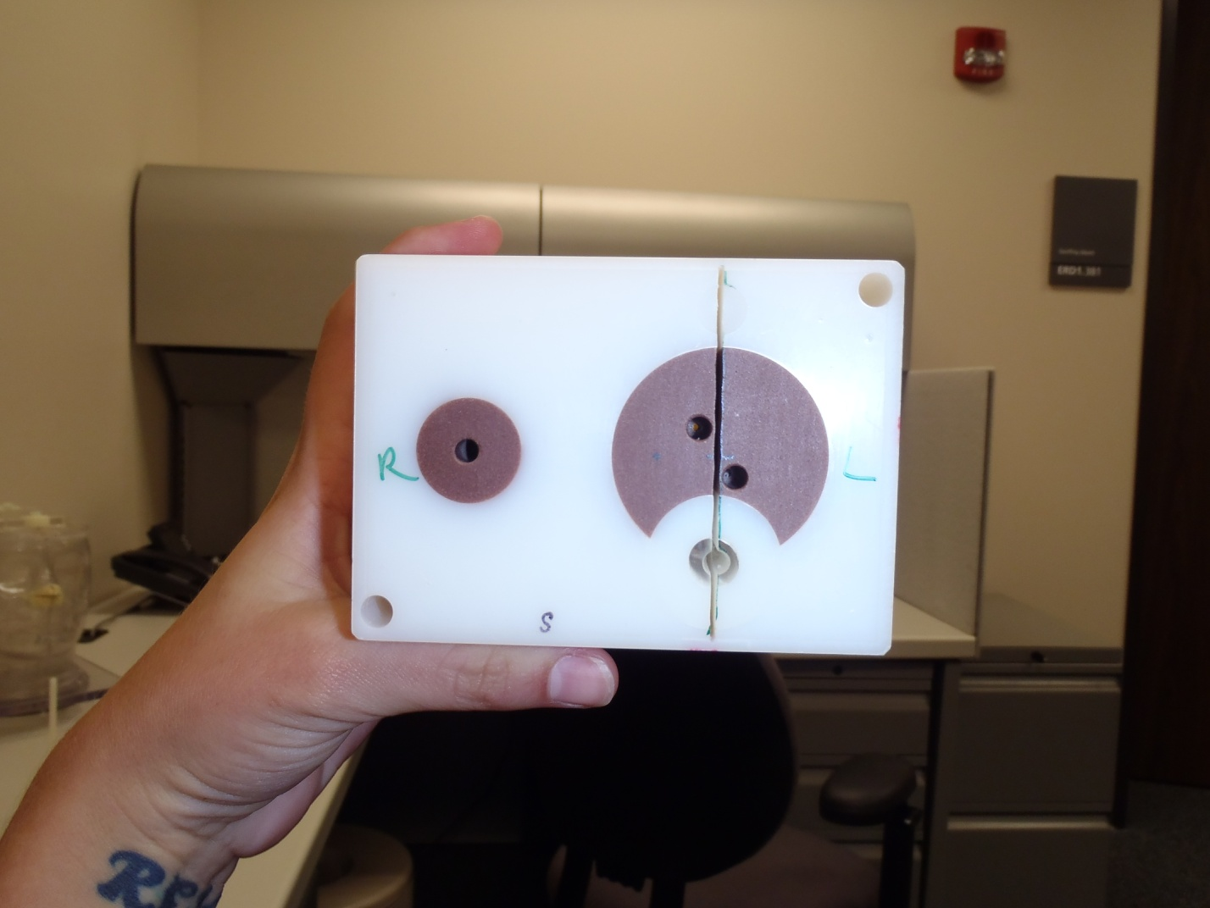
Results – Symmetry
Angular steering, in-plane ~3.5%
Angular steering, cross-plane ~3.5%
CROSS-PLANE
 | Standard Plan | Complex Plan
Dose difference from baseline | 3% | 3%
# of TLD with sig. difference (p<0.05) | 2/6 | 3/6
 | Standard Plan | Complex Plan
Dose difference from baseline | 4% | 4%
# of TLD with sig. difference (p<0.05) | 6/6 | 5/6
Notes:
For our symmetry analysis, up to 3 and 4% dose differences were seen in the angular in-plane and cross-plane deliveries, respectfully, with more TLD showing significant differences from the baseline delivery in both cross-plane deliveries.

Slide 12
Results – Symmetry
Translational steering, in-plane ~3.5%
CROSS-PLANE
 | Standard Plan | Complex Plan
Dose difference from baseline | 4% | 4%
# of TLD with sig. difference (p<0.05) | 4/6 | 2/6
Notes:
And a similar difference was seen in the translational in-plane steering of up to 4%.

Slide 13
Summary
MLC
  More dose difference for complex plans
Beam Quality
  More dose difference for complex plans
Symmetry
  Appears to have some dose differences, film analysis required to complete assessment
The impact from 3 of 9 failure modes for IMRT dose delivery have been measured that can be used to assist in the determination of the severity score for the risk probability number
Stay tuned, more data to come
Notes:
So in summary, there were more TLD with significant dose differences in the complex plan deliveries for both the MLC positional errors and beam quality errors. We saw some significant differences in our symmetry TLD results as well, but really the trend is unclear and I think with the information from our film analysis, we will be better equipped to assess the results.
Overall, the impact from 3 of our 9 physical failure modes for IMRT dose delivery have been measured, and we will be able to use this information in the determination of the severity score for the risk probability number.
Stay tuned for more data to come.

Slide 14

Thank you!
This work supported by DHHS grants CA10953 and CA81647
Acknowledgements
Dr. David Followill
Dr. Stephen Kry
Dr. Peter Balter
Dr. Geoffrey Ibbott
Adam Yock
Austin Faught
Joey Cheung
Andrea Ohrt
Miguel Herrera
Nicholas Murray
Carrie Armador
Andrea Molineu
Ryan Grant
Questions?

